Slide 1
Entertainment Show Platform
Data Base Project

Slide 2

Schema Squad
Mustafa Ihab
Mohamed Gamal
Kareem Mohamed
Ismail Abdelaziz
Eyad Mustafa
Supervisor :
Dr Wael Zakaria
Dr Mohamed Hashem

Slide 3

Importance of Entertainment Show Platform
1) We want to establish A platform for Entertainment Show.
2) First we need to establish A database that we will use in order to manage this platform.
3) This database will store some important information about users , actors , directors , Shows , production companies and more as we will show I the project.

Slide 4


REQUIERMENTS
The Following database is for Entertainment shows Platform :
A) We want to keep track of the company that produces these shows by gathering information about the company : “ founded year , Name , ID “.
B) We also keep track of each entertainment show : Name, year , the date they were released ,the production budget , the country it was made in , language , type , duration , specific age that allowed to watch a certain show.
C) Also store information about numbers of Episodes and seasons for each series and TV shows.
D) We also store data about each Actor , Director and Announcer : SSN , First name , Last name , Gender , the Date of Birth and Nationality. Actors can participate in different movie & series as well as Directors , Announcers introduce the TV shows with different celebrities.
E) Finally we keep data about each Viewer by collecting ID , Name , Birth Date. Every viewer has one profile which keep personal information about that one viewer like Email , Password , Nick Name and it does not repeat , method of payment , subscription type. Viewer can watches as many shows as he likes and can also rates them.

Slide 5

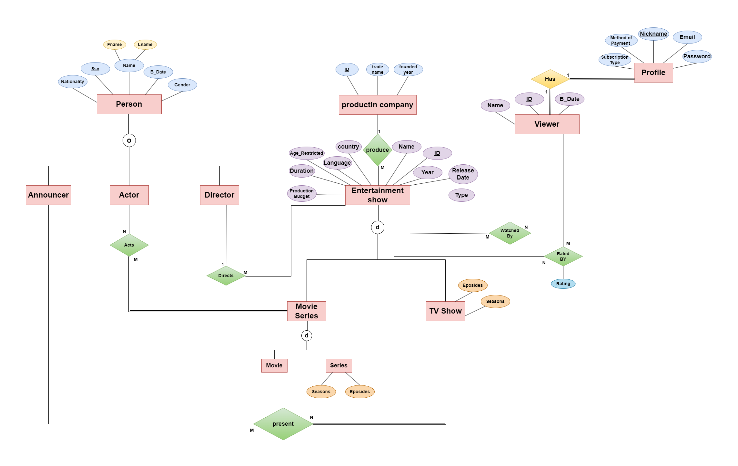
EER-Diagram

Slide 6

Relation Model
1)Production company (Id , Name , Founded_Year )
2)Movie ( Movie_id )
3)Entertainment Show ( Id , Name , Year , Release date , Country , Language , Duration, Production Budget , Age_Restricted , Type , Company_Id , Director_Id )
4)Tv Shows ( Tv_ShowId , Seasons , episodes)
5)Series( Series_Id , Seasons , episodes)
6)Person ( SSN , Fname , Lname , Bdate , Gender ,Nationality)
7)Actor (PSSN)
8)Director(PSSN)
9)Announcer(PSSN)
10)Viewer(Id ,Name ,Bdate )
11)Profile(Nickname , Email ,Password , Subscription Type ,Method of payment, Viewer_Id )
12)Acts(Movie_Id , Series _Id , Actor _ SSN )
13)present(Announcer_SSN , Show _ Id )
14)Watched by(Entertainment_Show Id , Viewer_Id )
15) Rated by(Entertainment_Show Id , Viewer_Id , Rating)

Slide 7

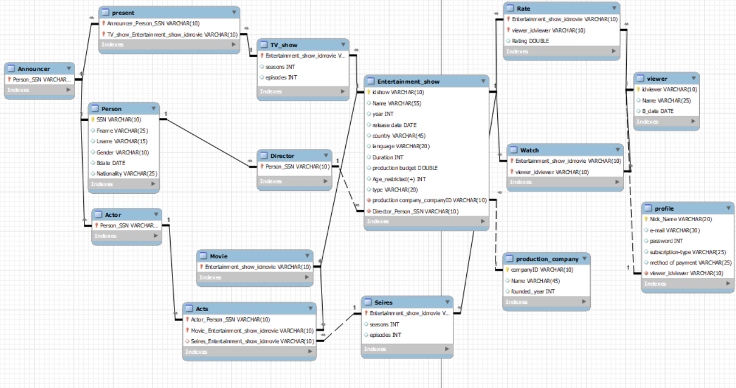
ER-Diagram on WorkBench

Slide 8

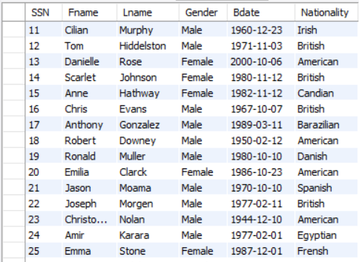

Relation Schema
Person

Slide 9
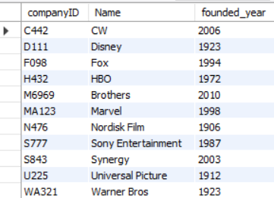


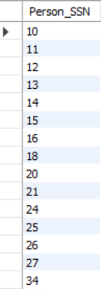
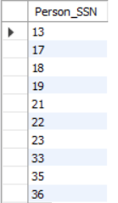

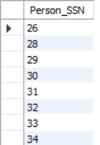
Production Company
Director
Announcer
Actor

Slide 10

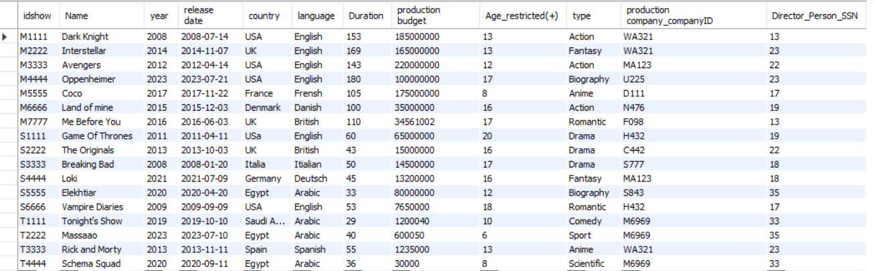
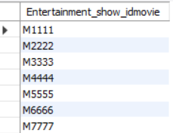
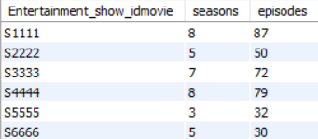
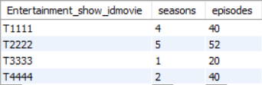
Entertainment Show
Movie
Series
TV Show

Slide 11

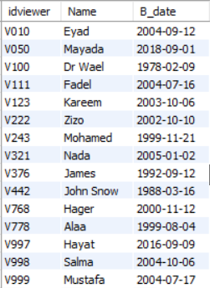
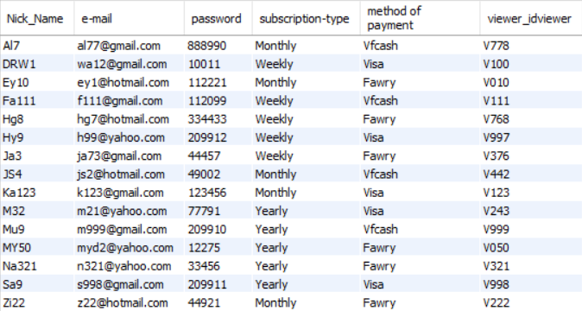

Viewer
Profile

Slide 12
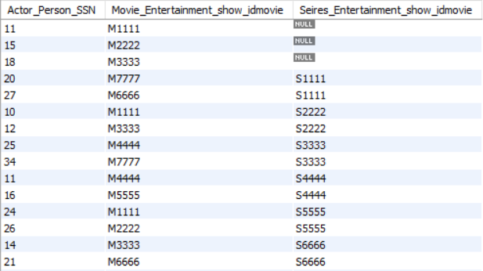
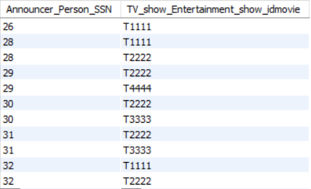

Acts
Present

Slide 13
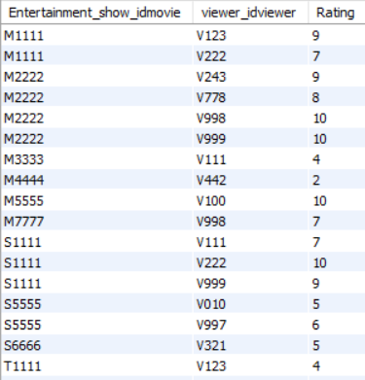
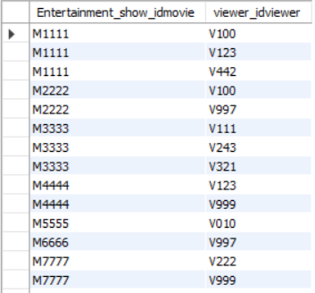

Rate
Watch

Slide 14
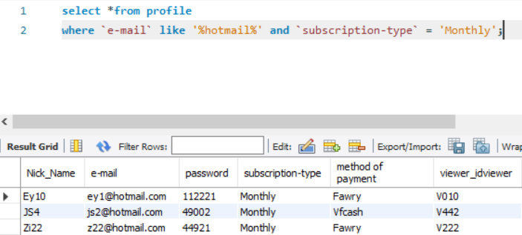
Queries
Queries on one table :
1-) Retrieve Profile Data of users whose email hotmail and subscription type is Monthly.

Slide 15
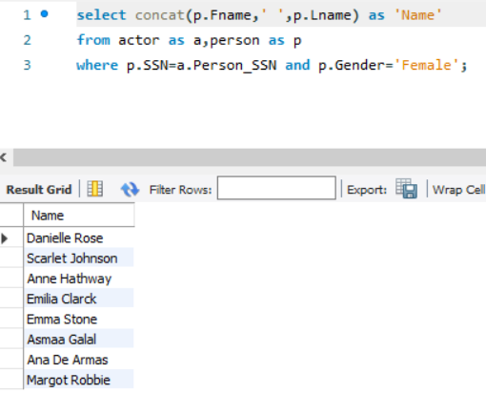
2-)Retrieve The Name of each female actress.

Slide 16
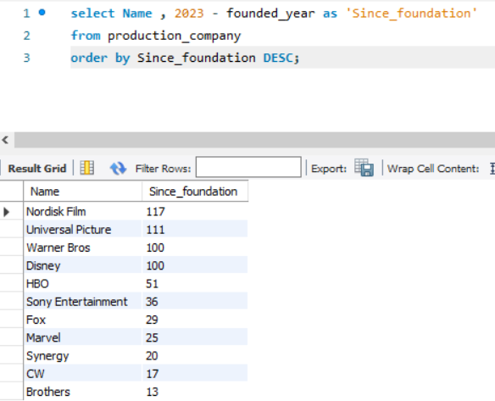
3-)Retrieve Company name and years since foundation in descending order.

Slide 17
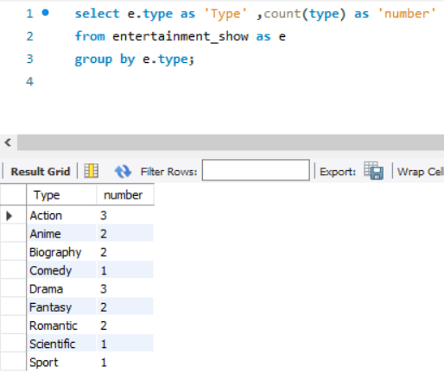
4-)Retrieve Entertainment Shows Type and their number.

Slide 18
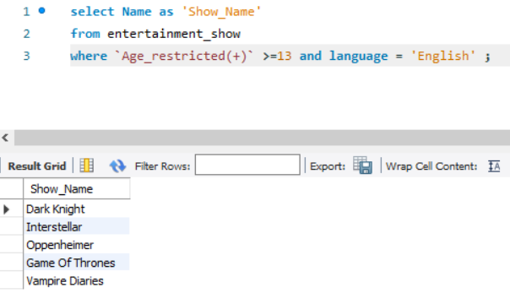
5-)Retrieve Show Name that kids can watch under parents guide (PG13) and Language "English“.

Slide 19
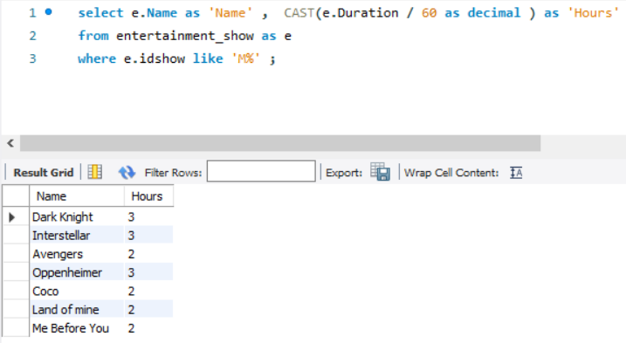
6-) Retrieve Movie Name and it's duration in hours.

Slide 20
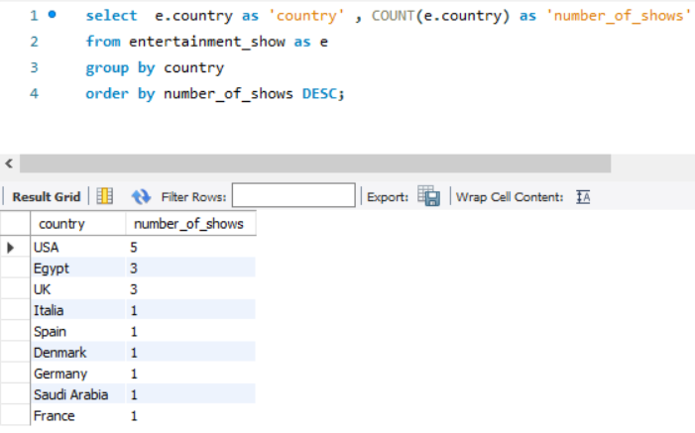
7-) Retrieve the country name with shows that is related to it.

Slide 21
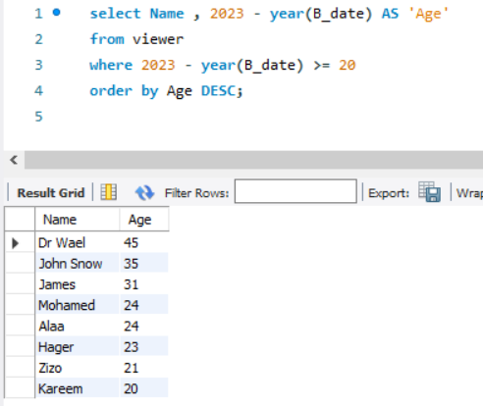
8-) Retrieve name of each viewer with age greater than 20.

Slide 22
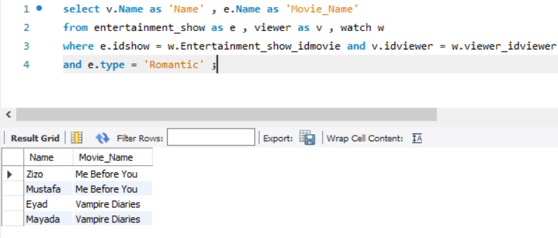
Queries on many tables & joins :
1-)Retrieve The name of viewer who watches Romantic shows.

Slide 23
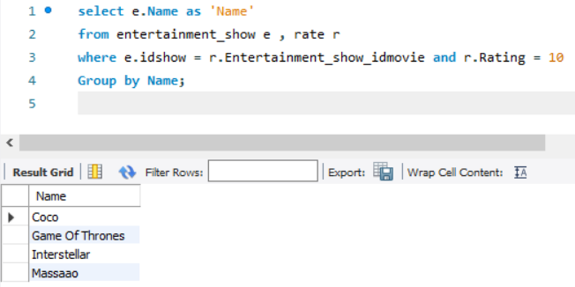
2-) Retrieve Name of shows that got at least one ten rating.

Slide 24
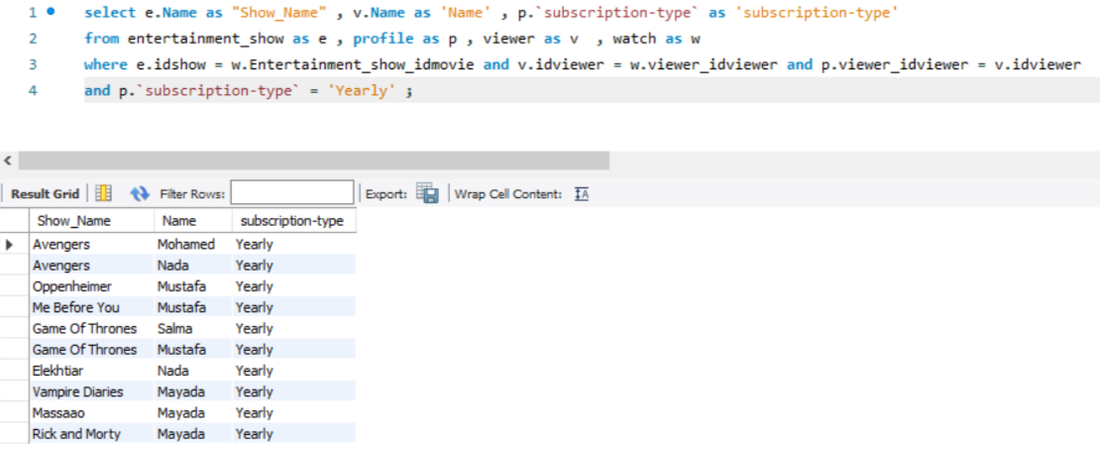
3-) Retrieve Viewer Name , show Name , such that viewer method of payment is Yearly.

Slide 25
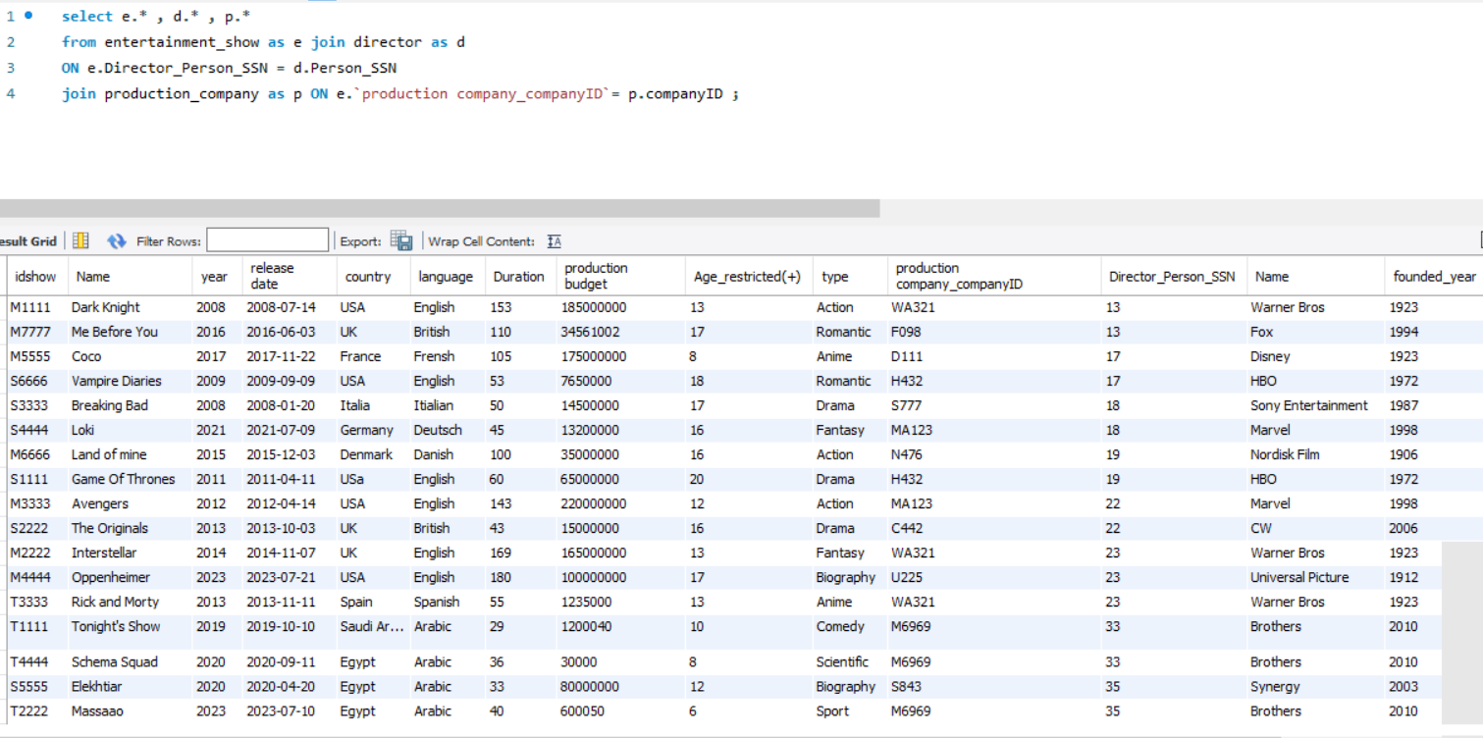
4-) Retrieve All information about entertainment show , production company and director id.

Slide 26
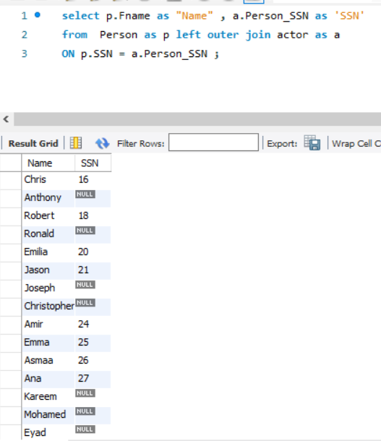
5-) Retrieve every Person Name and SSN if the person is an actor even if it's null.

Slide 27
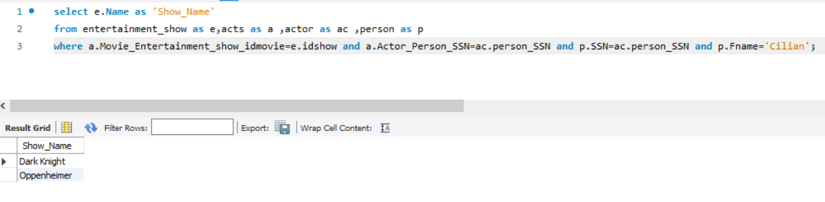
6-) Retrieve All Movies of Cillian Murphy.

Slide 28
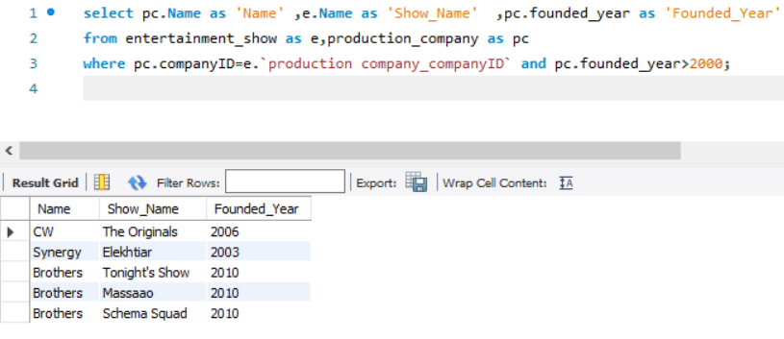
7-) Retrieve Show Names of Show That has been produced by a production company that was founded after 2000.

Slide 29
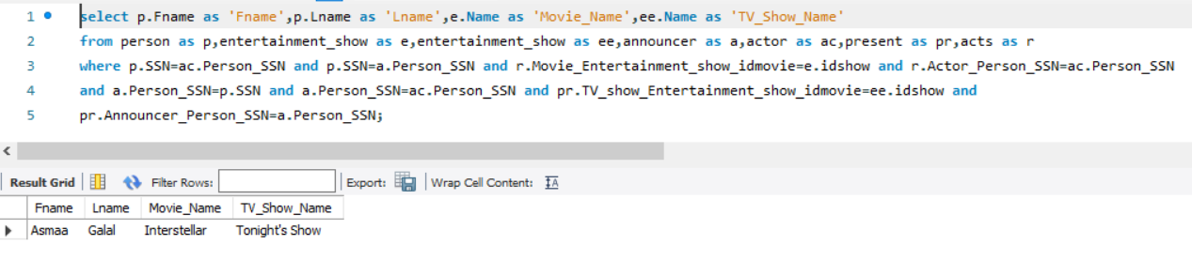
8-) Retrieve The Name of a person whose an actor and an announcer at the same time.

Slide 30
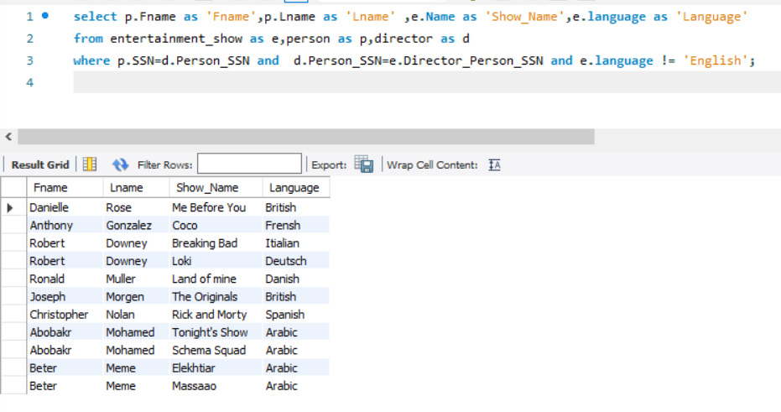
9-) Retrieve Director Name , Show name that's language is anything but "English“.

Slide 31
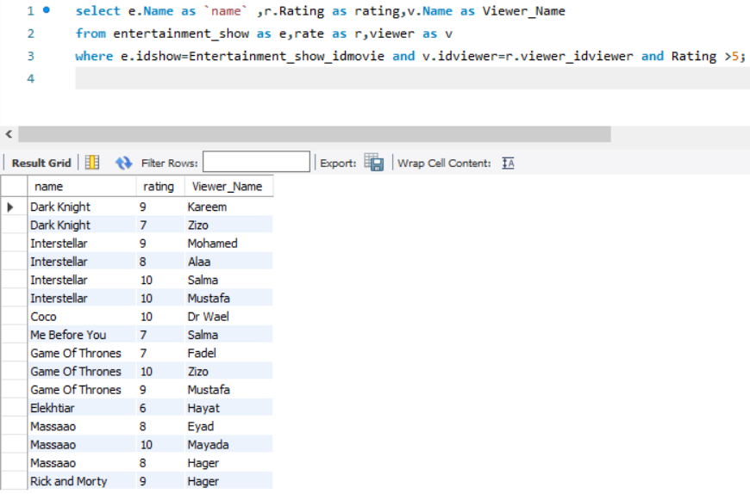
10-) Retrieve The Name of the Entertainment show which Rated by more than 5 from the viewer and also the viewer Name and The rate he gave to that certain show.

Slide 32
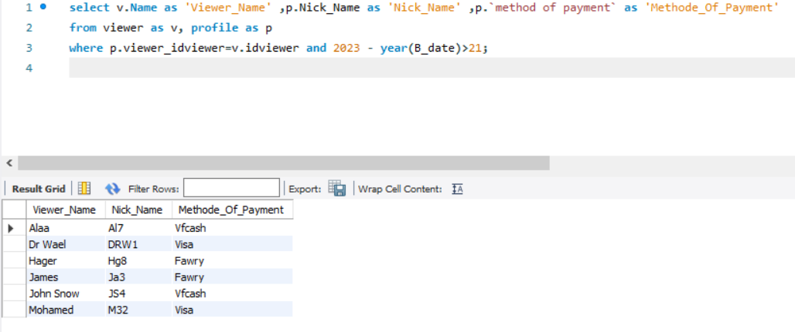
11-) Retrieve Nickname , Name , Method Of Payment of each viewer that is older than 21.

Slide 33
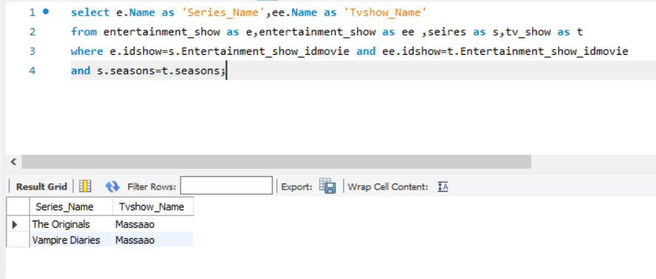
12-) Retrieve series ,tv show Names with the same Number of Seasons.

Slide 34
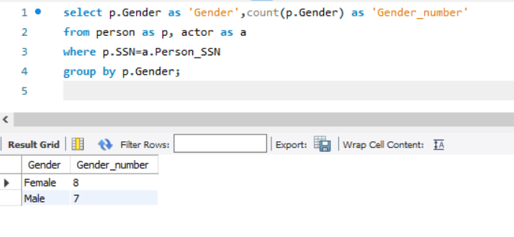
Queries using Aggregate functions :
1-) Retrieve number of Male actors and Female actress.

Slide 35
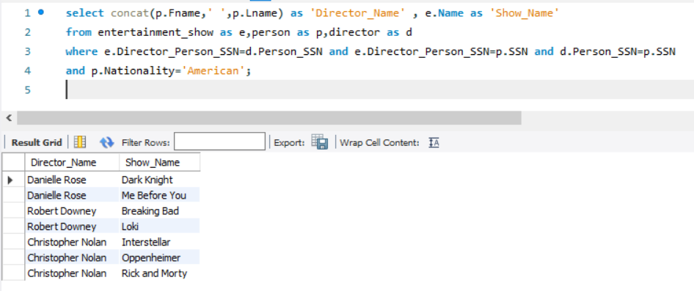
2-) Retrieve Director Name that's Nationality is American and the show it produces.

Slide 36
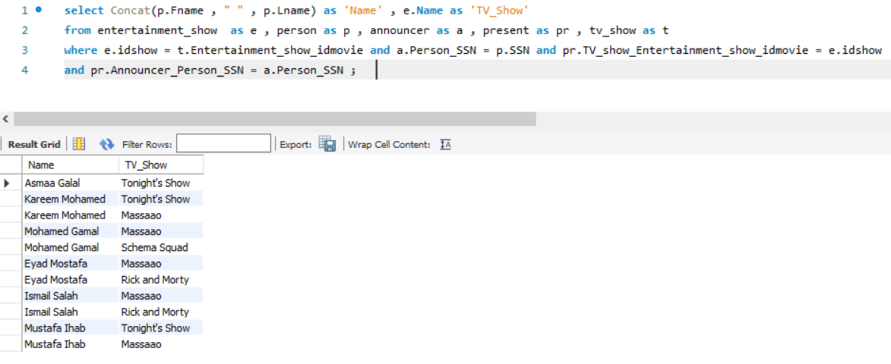
3-) Retrieve the Announcer Name and the show that he presents it.

Slide 37
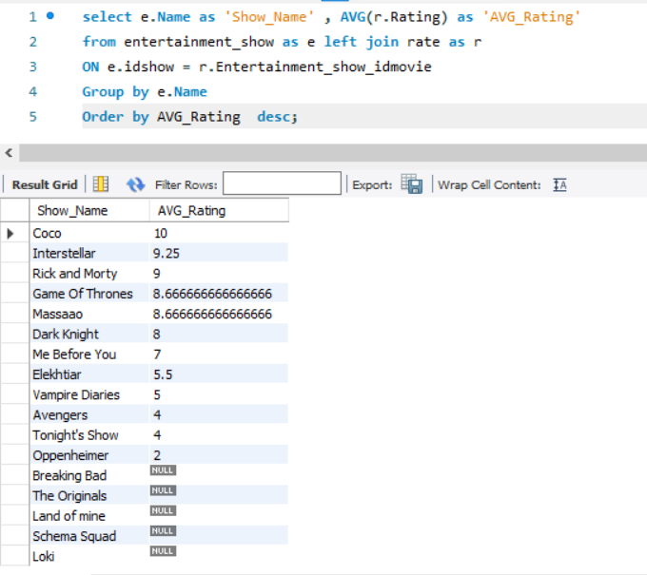
4-) Retrieve Average rating of each Entertainment show in a descending.

Slide 38
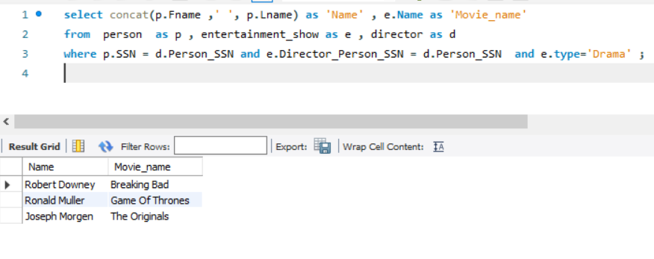
5-) Retrieve Director Name of the Show Name that's type is Drama.

Slide 39
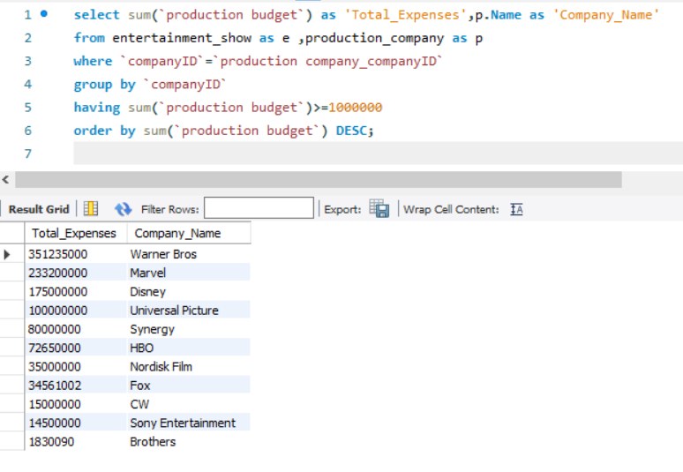
6-) Retrieve Name of Production Company with total expenses greater than million.

Slide 40
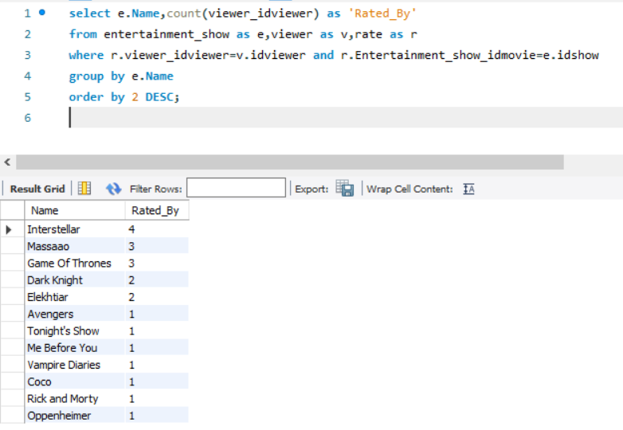
7-) Retrieve show Name with the number of viewers that rated it.

Slide 41
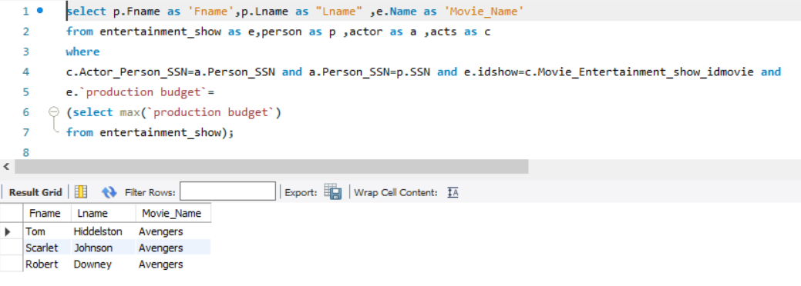
Some nested Queries :
1-) Retrieve Actors name for the movie with the highest "Production Expenses“.

Slide 42
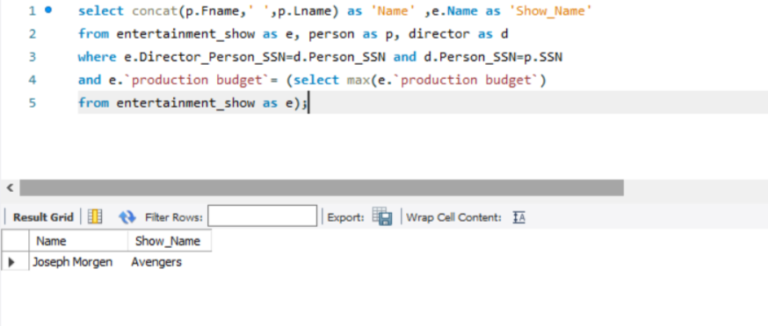
2-) Retrieve Name of the director that produces the show with the highest Production Budget.

Slide 43
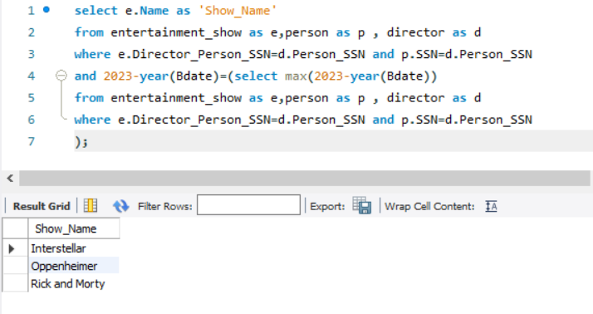
3-) Retrieve Show Name that was directed by The older director.

Slide 44

Thank You.

